Slide 1
“Day is Done”
Winning the peace

Slide 2
Historian Eric Foner writes that, “virtually from the moment the Civil War ended, the search began for legal means of subordinating” the black population

Slide 3
We must keep the ex-slave in a position of inferiority. We
must pass such laws as will make him feel his inferiority;
and while we give him ample protection in his ‘person and property’ we are finally lost if we permit ourselves, by an abstract would-be philosophical reasoning to admit him [to] any position that [seems] of the slightest equality with the white man.
Reprinted in New York Tribune, November 15, 1865.

Slide 4
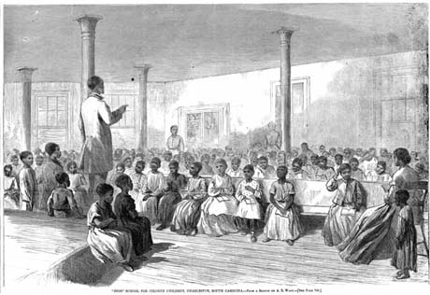
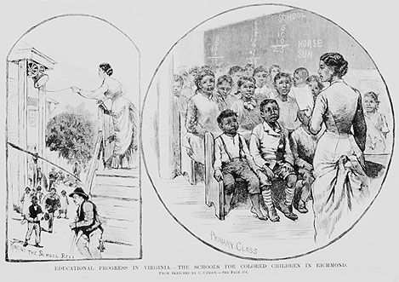
"Zion" School for Colored Children,
Charleston, South Carolina, 1866

Slide 5
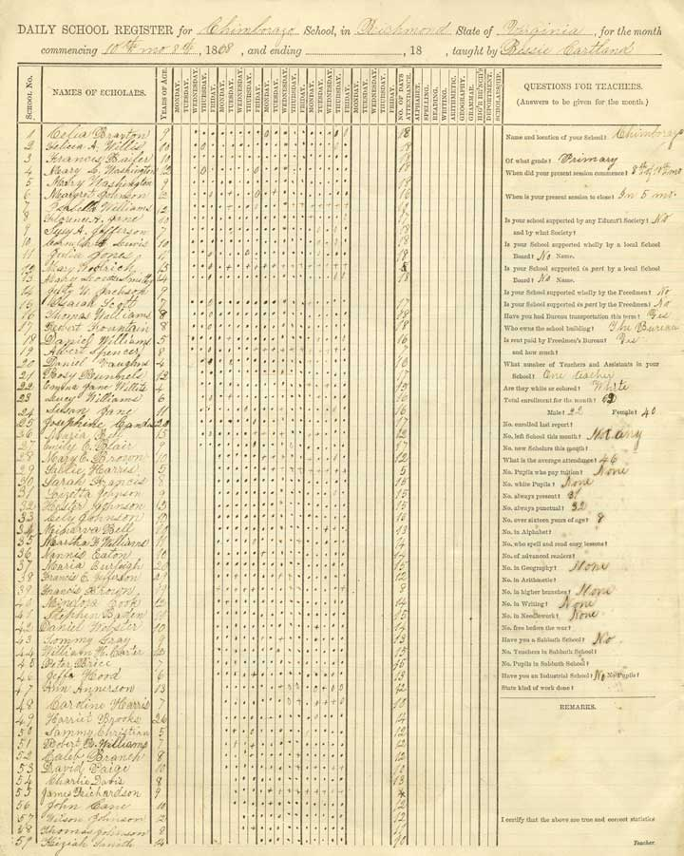
“Where opportunities did not exist, education would open the doors.”
Taken from My Great, Great Grandfather’s Journey to An Island of Freedom by Col Lafayette Jones Jr.

Slide 6
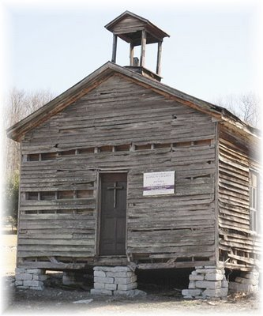
“the sheer power of religious faith in black communities, bolstered now by experience, reinforced African American optimism.” David Blight

Slide 7
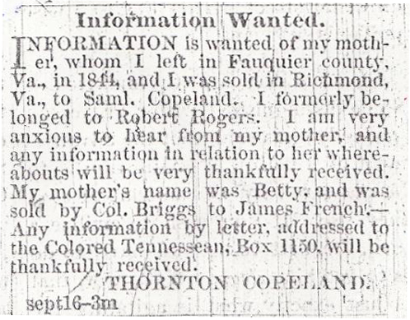

Slide 8
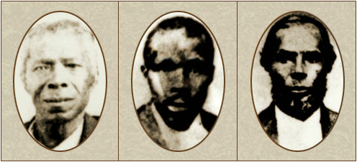
Three of ten black delegates to the 1868-69 Constitutional Convention: (from left to right) Benjamin Franklin (B.F.) Williams, Charles W. (C.W.) Bryant, and Stephen (S.) Curtis.

Slide 9
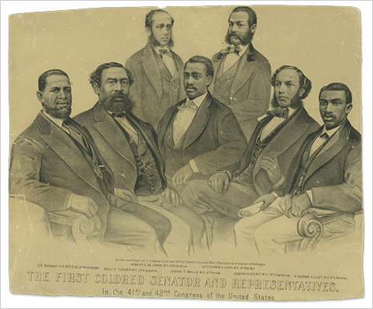

Slide 10
Bibliography
Blackmon, Douglass A. Slavery By Another Name: The Re-Enslavement of Black Americans from the Civil War
to World War II. Anchor Books, 2009. Also a documentary by the same name.
Daley, Jane. “Deference and Violence in the Postbellum Urban South: Manners and
Massacres in Danville, Virginia. The Journal of Southern History,” August 1997, Vol. 3,
(August, 1997), pp. 553-590.
Douglass, Frederick. Narrative of the Life of Frederick Douglass, an American Slave:
Written by Himself
DuBois, W.E.B. Black Reconstruction in America 1860 -1880. Antheneum, New York, 1992.
Foner, Eric. Reconstruction: America’s Unfinished Revolution 1863 -1877. Harper & Row Publishers
New York, 1988.
Foner, Eric. A Short History of Reconstruction (Updated Edition). Harper Collins, 2015.
Rose, Willie Lee. Rehearsal for Reconstruction: The Port Royal Experiment. University of Georgia
Press, 1999.
Williams, Heather Andrea. Help Me to Find My People: The African American Search for
Family Lost in Slavery. The University of North Carolina Press, 2012.

