Slide 1
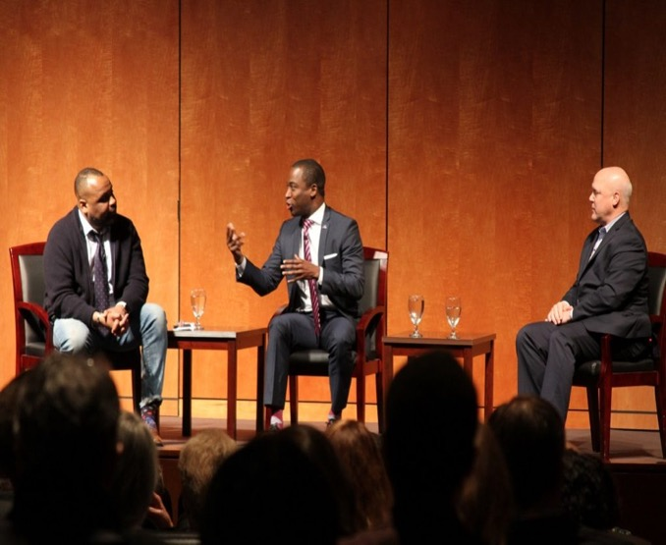
Memory & History, History & Memory
The Problem of Usable Pasts, the Lost Cause, & the Search for Historical Truth

Slide 2
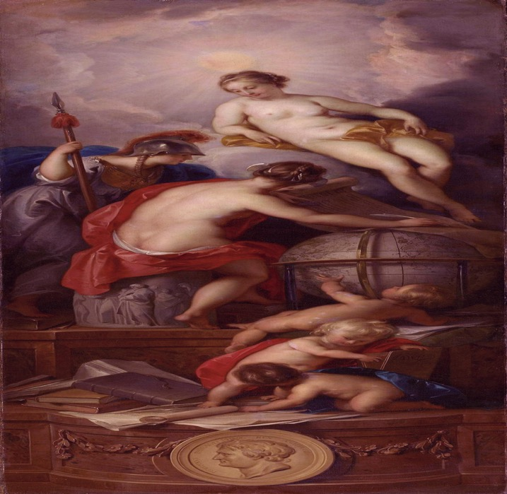
What is history?
History, the naked truth (right), supervises the actual writing of history below– Jacob de Wit, 1754

Slide 3
Heritage v. History
Heritage is a fundamentally value-based endeavor– it is based on features of the past that people decide to keep, often in spite of evidence and information. It is not what happened in the past only, but what some have decided is worthy of preservation.
History, attempts to reconstruct and understand the events experiences of historical actors. History follows rules of evidence and interpretation (i.e., the historical method). The practice of history requires constant debate and revision: especially as new evidence comes to light and discoveries (not only historical discoveries) give rise to new interpretations.

Slide 4
Memory & History
… history is anything but agreeable. It is not a collection of facts deemed to be "official" by scholars on high. It is a collection of historians exchanging different, often conflicting analyses… History may be an attempt to memorialize and preserve the past, but it is not memory; memories can serve as primary sources, but they do not stand alone as history. A history is essentially a collection of memories, analyzed and reduced into meaningful conclusions-- Michael Conway, The Atlantic.
Michael Conway, “The Problem with History Classes,” The Atlantic, 16 March 2015.

Slide 5
Real vs. “Imagined” History– statues are reflections of things people take seriously
A. Thomas Schomberg, commissioned--1982
1971
Stephen Lane, unveiled 2015

Slide 6
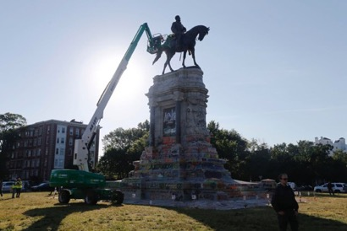
Charlottesville was about memory, not just monuments– the age old battle between heritage and history
Confederate sympathizers see these monuments as essential to their heritage.
Other see them as reflections of a mythologized, exclusionary past. A past that fails to take the entirety of history into account.

Slide 7
https://www.businessinsider.com/confederate-statues-meaning-timeline-history-2017-8

Slide 8
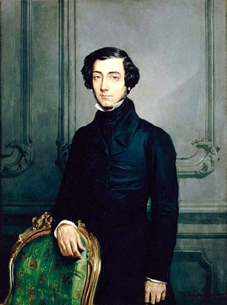
Alexis de Tocqueville, French scholar, 1805-1859
Tocqueville’s Quandary:
He [Alexis de Tocqueville] defined the alternatives available to the slave-holding States with simplicity. They might emancipate the Negroes and treat them with some degree of civility, or perpetuate their serfdom for as long as possible. Emancipation, he saw, would solve few problems in the immediate future. The evidence suggested that freedom for the Negro intensified rather than alleviated the prejudice on the part of whites.
(U.S. Commission on Civil Rights, Freedom to the Free, 1963)
Hayter:
We know now, that the United States chose the latter.
The story of the Jim Crow South is the story of the perpetuation of African American serfdom, a set of beliefs designed to justify that serfdom, and African American resistance to both
The North, the Lewis story, is an immigrant story. The story of African Americans beyond the South is, in many ways, an immigrant story. This story of migrants belies the politics of upward mobility that undergirds the American dream. Lewis may have triumphed in the the Ring, but the story of African Americans migrants beyond the South tells a story

Slide 9
The Lost Cause Jefferson Davis Memorial– Richmond, Virginia (unveiled in 1907)
The Lost Cause is an interpretation of the American Civil War that seeks to present the war, from the perspective of Confederates, in the best possible terms. Developed by white Southerners, many of them former Confederate generals, in a postwar climate of economic, racial, and social uncertainty, the Lost Cause created and romanticized the "Old South" and the Confederate war effort, often distorting history in the process.
1. Secession, not slavery, caused the war
2. Blacks were faithful, happy slaves
3. Slaveowners were benevolent paternalists and slavery was a benign institution
4. Soldiers were heroic
5. Robert E. Lee was the most heroic soldier
6. South was destined to lose because of Northern advantage in resources and men
https://www.encyclopediavirginia.org/Lost_Cause_The
Jefferson Davis Memorial– Richmond, Virginia (unveiled in 1907)

Slide 10
In defense of the past, present, and future.
During the late nineteenth and early twentieth century, private organizations (such as the United Daughters of the Confederacy, UDC) spearheaded movements to legitimize the Confederacy. As early as 1919 (as Civil War veterans began die from aging), the United Confederate Veterans (UCV) resolved to embed their beliefs into American history and history textbooks. Mildred Lewis Rutherford (a prominent educator, Ku Klux Klan sympathizer, and member of the UDC), the Sons of Confederate Veterans (SCV) and the UCV established the Rutherford Committee in Atlanta, Georgia. Rutherford and the committee eventually published the now infamous pamphlet of Lost Cause beliefs, A Measuring Rod to Test Textbooks, and Reference Books in Schools, Colleges, and Libraries. “Measuring Rod” set a standard. It contained key assertions of the Lost Cause, urged Southerners to ignore historical sources, and romanticized the Confederate war effort.
Mildred Lewis Rutherford, 1851-1928

Slide 11
“Measuring Rod”
Argued:
“Reject a book that calls the Confederate soldier a traitor or rebel… reject a book that says the South fought to hold her slaves… reject a book that speaks of the slaveholder as of the South as cruel and unjust to his slaves… reject a text-book that omits to tell of the South’s heroes and their deeds…”
Lost Cause supporters spent the years after 1919 urging libraries, colleges, and school boards to ban books that emphasized the Union war effort, the role of slavery in causing the war, and the inhumanities of the slave system..

Slide 12
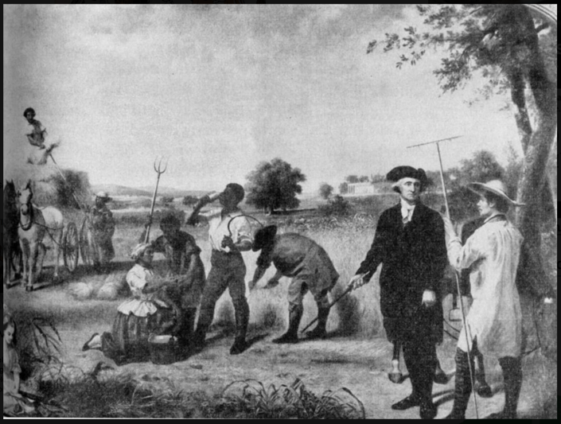
Virginia: History, Government Geography– ca, mid-20th century
The same seventh-grade textbook depicted this painting of George Washington overseeing his slaves at Mount Vernon. The caption said Virginia “offered a better life for Negroes than did Africa.

Slide 13
A benign institution?
The Richmond Times-Dispatch just recently analyzed these textbooks. The ”Cavalier Commonwealth” held:
---The slave "did not work so hard as the average free laborer, since he did not have to worry about losing his job. In fact, the slave enjoyed what we might call comprehensive social security. Generally speaking, his food was plentiful, his clothing adequate, his cabin warm, his health protected and his leisure carefree."
---Slave owners and slaves "understood that bondage as they knew it was not totally evil; both realized that enslavement in a civilized world had been better in many respects for the Negro than the barbarities he might have suffered in Africa.”
---Lee "came as close as any man to fulfilling the best ideals of what a Virginia gentleman should be."

Slide 14
Analysis of the historical documents revealed
Slaves were often sickly (e.g., dysentery, typhoid, hepatitis, infant mortality rates, worms, tetanus) and they constantly challenged the boundaries of the master-servant relationship.
Niklas Thode Jensen, For the Health of the EnslavedSlaves, Medicine and Power in the Danish West Indies, 1803-1848
Historians generally agree that slavery, more than any other issue, brought on the war. Even a cursory search of the University of Richmond’s digitization of the Virginia secession convention demonstrates this--- the word slavery comes up 512 times, while states rights is mentioned a mere 29 times.
https://secession.richmond.edu
Historical documents demonstrate that Lee’s benevolence as a slave master, on the plantation that now contains Arlington Cemetery, is deeply questionable.
https://www.historynet.com/robert-e-lee-slavery.htm
Before its construction in 1890, Virginia’s governor, Fitzhugh Lee, not only refused to build Richmond’s Lee statue on the capital grounds (where it was intended to be placed), he openly referred to Monument Avenue as a “plain business proposal.”
Kirk Savage, Standing Soldiers, Kneeling Slaves: Race, War, and Monument in Nineteenth-Century America

Slide 15
Monument Avenue, the sources reveal, was a naked real-estate development ploy

Slide 16
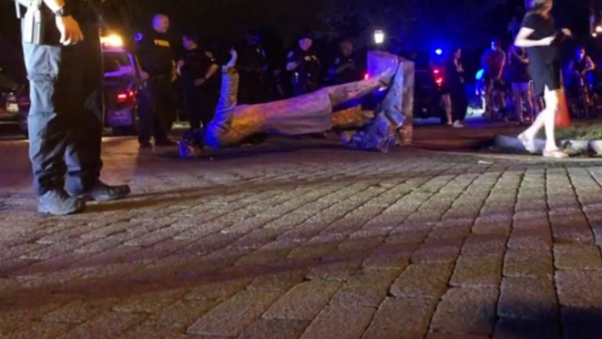
Louis P. Nelson & Claudrena N. Harold
“Seen through the lens of history, these statues are more easily recognized as silent heralds of deeply entrenched systems of political disenfranchisement, educational injustice, health inequity, and neighborhood marginalization.”
Charlottesville 2017: The Legacy of Race and Inequality

Slide 17
Heritage Questioned
Confederate monuments represent the types of symbols that emerge in the absence of democracy. They emerge when people attempt to rationalize culture built from human bondage, a Civil War wherein hundreds-of-thousands of Americans perished, and a political system that stole democracy by robbing black Americans and poor whites of their constitutional liberties.

Slide 18
The most common first name of history teachers across America, for far too long, has been “coach”
In scrutinizing how the Lee monument came to be, Bryant was actually questioning how and why history is told. A 15-year-old delved into affairs of not just history, but also historiography — the cumulative effort of historians to interpret the past — and history education. In doing so, she ignited “The Battle for Charlottesville’s Soul” and demonstrated that America’s inability to grapple with its tortured racial history has educational implications.
Bryant’s quest spotlighted a serious flaw in our history education. Most students in the United States learn history as an established, linear narrative — a set of facts that point toward progress. The Advanced Placement (AP) system has rushed generations of students through vital portions of American history (recent American history is mostly untold). Generally, the teaching of history urges rote memorization over investigating the process of writing historical narratives and recognizing “how inherent biases shape conventional instructional materials.”
The result: In an era where nostalgia often masquerades as history, many young Americans know little of the past and the forces that influence its production.
Julian Hayter, “Charlottesville was about memory, not monuments,” Washington Post, August 10, 2018

Slide 19
We’re paying for the sin of omission
I have written elsewhere about the sin of omission and mythologies that for far too long have characterized American history. Suffice it to say, the teaching of the American past is as much about productive citizenry and heritage as history. Until recently, textbooks portrayed America as a triumph narrative. The story often emphasized European progress, colonists’ mastery of nature and natives, and the divine providence of Constitutional republicanism.
Until African Americans and racial minorities began to write their own histories, stories of the United States were written by and for white Americans. There’s nothing controversial about this statement. Crack open any textbook from the mid-twentieth century—minorities are not merely absent, when they surface in these texts, they’re almost always portrayed as inconsequential and dehumanized figures. African Americans, for instance, are actors without agency or event.
https://thecheatsmovement.com/voices-revising-revisionism-beyond-the-lost-cause-by-julian-hayter-ph-d/

Slide 20
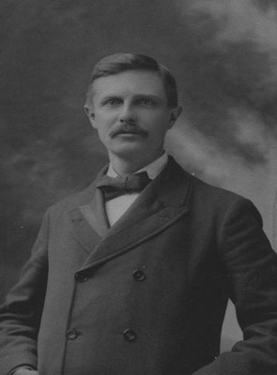
On The Mythology of Revisionism
“Each age writes the history of the past anew with reference to the conditions uppermost in its own time.”
“Those who insist that history is simply the effort to tell the thing exactly as it was, to state the facts, are confronted with the difficulty that the fact which they would represent is not planted on the solid ground of fixed conditions”
Prompts from the present can inform inquiries into the past. The continuity of American racism has forced a good number of scholars and educators to question triumph of narrative of post-civil rights America. That racism is being more thoroughly filmed has shocked America into realizing just how far we have and have not come. These events and images have forced experts back to the drawing table to think intently about our past, what histories we value, and how both continue to shape the present.
Frederick Jackson Turner, 1861-1932

